Slide 1
LT: I am learning about variables. The purpose is to understand the factors within an experiment. Today I will learn what a variable is and what the different types of variables are within an experiment.
Warm Up: How many variables did you have in your Slow flier experiment?
CW: Cornell notes on variables
HW: Write a reflection on your slow flier experiment….
Did you have variables?
did you have controlled variables?
Did all your variables stay the same?
How many changed variables did you have?

Slide 2
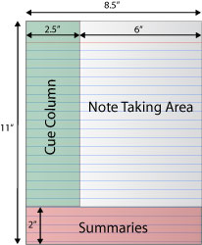
The summary does not have to be on each page… however, it can if you want. The summary must be at the end of the class notes!

Slide 3
Variables
Variables
A. Something in the experiment that will change.
Vari means to change.
B. To make an investigation scientific you have to have at least three types of variables….an independent variable, a dependent variable and constant variables….

Slide 4
What’s a variable….
Anything within an experiment that can change the outcome/results of an experiment.
What’s a variable?
Anything within an experiment that can change
the outcome/results of an experiment.

Slide 5
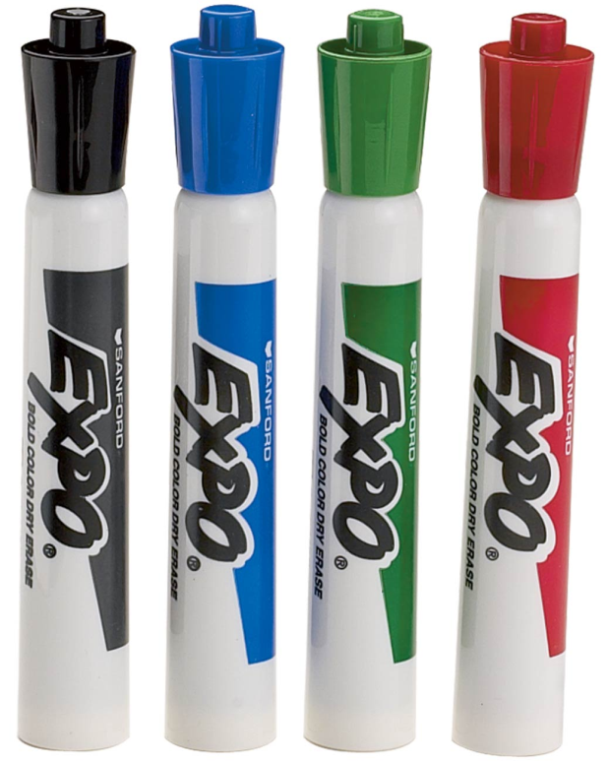
Solo Marker
Your task is to remove the index card from under the marker….
Rules:
You can use only one hand.
You can NEVER touch the marker!!
Draw a science sentence within your right-
hand side of your Cornell notes… You
should have a beginning, middle and end.

Slide 6
Solo Marker
What was the variables in this experiment?
The type of marker
The type of index card (size and condition)
The person removing the index card
The surface on which the index card and marker stood
The condition of the room
The hand method to remove the card

Slide 7
Solo Marker
What variables stayed the same? These are the controlled/constant variables.
The type of marker
The type of index card (size and condition)
The person removing the index card
The surface on which the index card and marker stood
The condition of the room
Every variable stayed the same but ONE…
This is called the Independent variable.

Slide 8
What are the constant variables?
Anything within an experiment that can change the outcome/results of an experiment.
What is an independent variable?
What are constant
Any variable within an experiment that remains the same. CONSTANT
variables?
What is an independent variable?
The ONE variable that is changed or manipulated.

Slide 9
Why can there be only ONE changed variable?
Anything within an experiment that can change the outcome/results of an experiment.
How many variables can be changed in an experiment? Why
Every experiment needs to be a CONTROLLED experiment so only one variable can be changed. Also if you change more than one variable they you do not have reliable results!

Slide 10
Inverted Cup
Remember to write a science sentence in the right-hand of your Cornell notes.

Slide 11
Inverted Cup Demo
Can you identify the variables?
Type of cup
Type of index card
The person who turned over the card….
Amount of water in each cup
What variables are the controlled variables?
Type of cups
Type of index cards
The person who turned over the card and cup
What variable was the ONE changed variable?
The amount of water

Slide 12
Think about the difference between…..
Variables
Control
As applies to an scientific experiment!!!!

Slide 13
What is the difference between a independent variable a variable and a control?
Independent Variable: Is the ONE change variable in an experiment. This variable is the reason for the experiment.
Variable: a factor that can change in an experiment.
Control: a factor that stays constant in an experiment.

Slide 14
Exit Ticket
Why are there variables that stay the same within an experiment?

Slide 15
LT: We will learn the expectations of an Exit Ticket. The purpose is to know what is needed to receive an “A”.
Warm-Up: Complete concept map for this weeks knowledge on your Daily Catch.
CW: Turn in reflection HW, Review exit ticket quality and complete pre-test.
HW: Get Daily Catch signed, and complete pre-test.

Slide 16
Exit Ticket Quality
A= ALWAYS use COMPLETE SENTENCES
B= Be sure to RE-STATE the question.
C= Communicate your thoughts using SCIENTIFIC VOCABULARY and with examples from class or real life.

Slide 17
Example to get a “5”
There are variables that stay the same to make the experiment controlled, for example if the cups were not the same in the class demo. the experiment would have different results. The cup experiment would had 2 changed variables.
Complete sentences
Re-stated the question
Used science vocabulary and had an example that made sense.

Slide 18
Example to get a “4.5”
There are variables that stays the same within an experiment because if it changes then the whole experiment changes. EX: the amount of liquid in the cup experiment.
Re-stated the question
Used an example from class and some scientific vocabulary…
But did not have complete sentences…. EX:

Slide 19
A “4” example
Why are there variables that stay the same because so you know what changed the outcome.
Complete sentence
Re-stated the question
Used some vocabulary but did not give an example

Slide 20
Do not forget to do your pre-test and get your Daily Catch signed!!

