Slide 1
Lab safety

Slide 2
LT: I will become familiar with lab safety vocabulary, rules and safety equipment locations within the science classroom.
CW: Vocabulary page, room map and some safety rules.
HW: Complete vocab page, map and some safety rules.

Slide 3
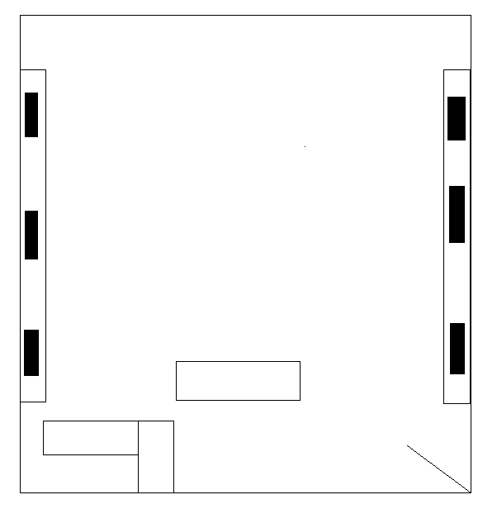

Slide 4
We are going to watch a video about lab safety please add this entry into your ISN
Rules within a science lab | Hazards within a science lab
1. | 1.
2. | 2.
3. | 3.
4. | 4.
5. | 5.

Slide 5
Science video on lab Safety
Lab Safety

