Slide 1
Lab safety

Slide 2
LT: I will become more familiar with lab safety vocabulary, and lab safety rules within the science classroom.
CW: Rules and Lab Safety Foldable.
HW: Complete Lab Safety Foldable. Think of an experiement you can do in class!

Slide 3
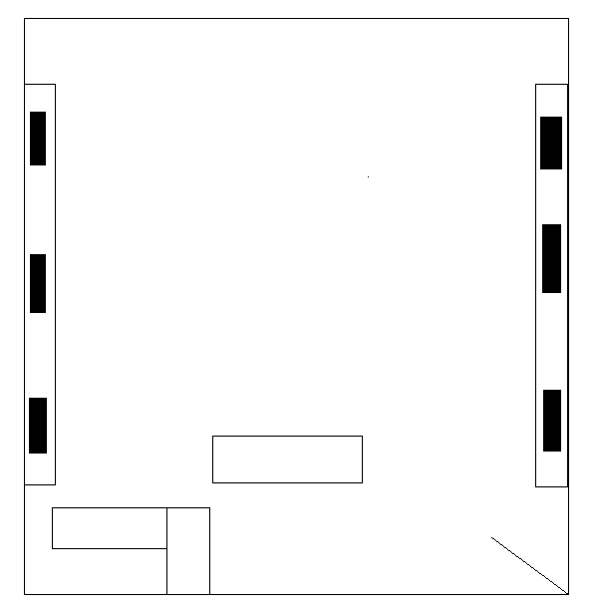

Slide 4
We are going to watch a video about lab safety please add this entry into your ISN
Rules within a science lab | Hazards within a science lab
1. | 1.
2. | 2.
3. | 3.
4. | 4.
5. | 5.

Slide 5
Science video on lab Safety
Lab Safety

Slide 6
Lab Safety foldable

