Slide 1
Major Geological Events
Concept Map Guidelines

Slide 2
Lt: I will synthesize the major geological event unit. The purpose is to organize details and attach learning to my background knowledge. Today I will create a concept map of all I have learned. CW: Organize my major geological event knowledge and place my understandings within a concept map. HW: Gather small pictures , work on your organization.
Concept Map Guidelines

Slide 3
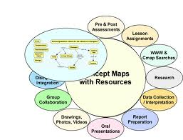
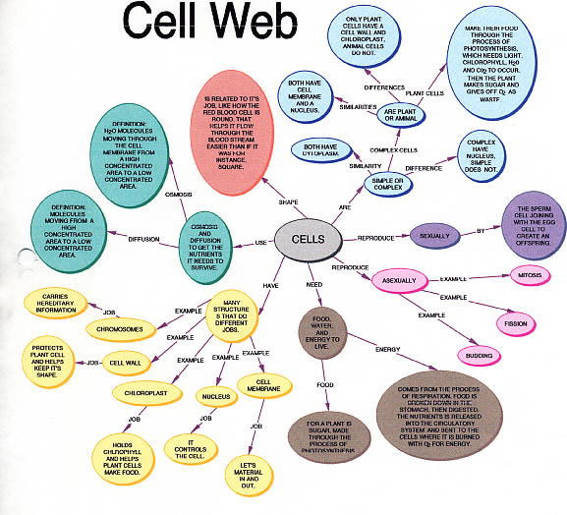
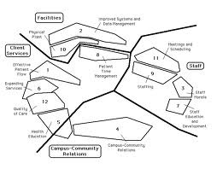
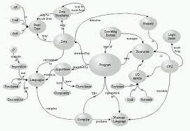

Slide 4
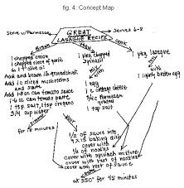
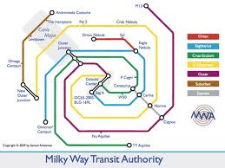
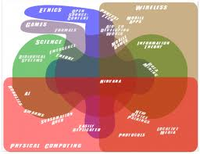
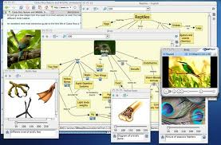

Slide 5
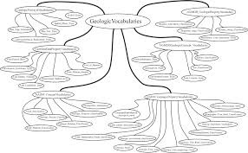
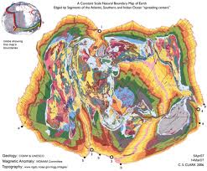
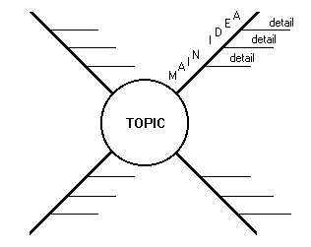
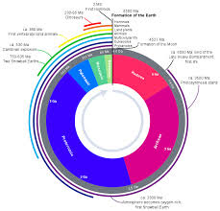

Slide 6
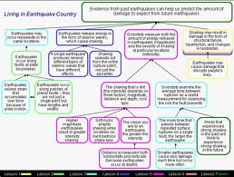
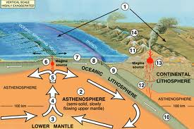

Slide 7
Step One
Write the complete standard within your concept map.
CAS 3.1 Major geologic events such as earthquakes, volcanic eruptions, mid-ocean ridges, and mountain formation are associated with plate boundaries and attributed to plate motions.

Slide 8
Step Two: Locate all your Daily Catch concept maps
Put your concept map in order. Review each map.

Slide 9
Step Three: Locate all your vocabulary cards
Organize your vocabulary cards into piles that relate to each other. By now you should know all the vocabulary words and be able to use them on your Unit Concept Map

Slide 10
Step Four: Review your notebook, Cornell notes and other additional information.

Slide 11
Step Five: Think of a graphic organizer (concept map design) you like best.

Slide 12
Step 6: Only Use pencil at first to get your basic design and facts down… then go back and add color!
PS. You may add pictures however they have to be pictures you print at home.

Slide 13
You will be grades on..
1: complete information
2. accurate information
3. neatness

