Slide 1
Patterns outside the inside of the Earth

Slide 2
Earth’s patterns
LT: I will begin to make sense out of patterns found on a map of the earth. The purpose is to apply the map clues/patterns to what is happening inside the earth to make the patterns. Today I will read a map and make inferences/observations of what I see.
Warm-Up: Which layer has the most impact on the earth’s crust? Justify your answer will reasoning.
CW: Reading and observing patters on a map. Answering questions of what I see on the map.
HW: None

Slide 3
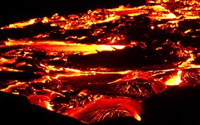
HEAT

Slide 4
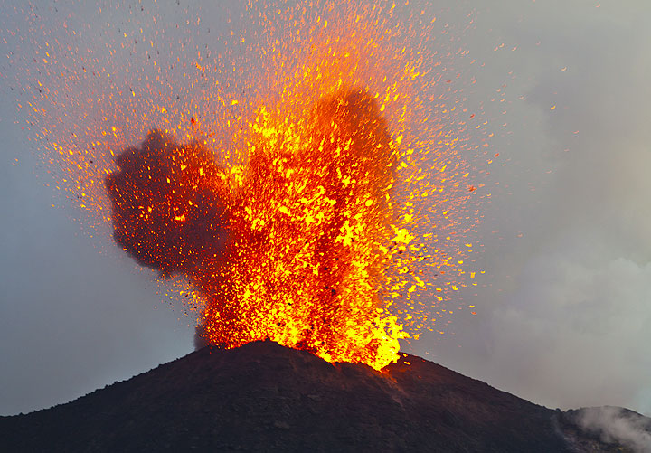
Pressure

Slide 5
A very Thin Crust

Slide 6
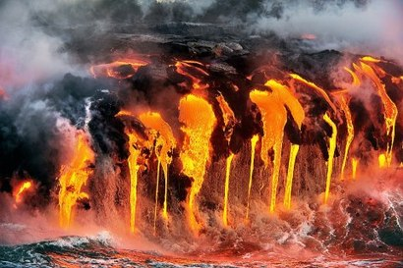
Something has to Give…

Slide 7
Can you figure it out by looking maps…can you find patterns?

Slide 8
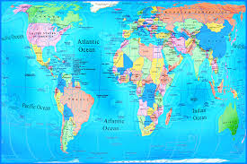
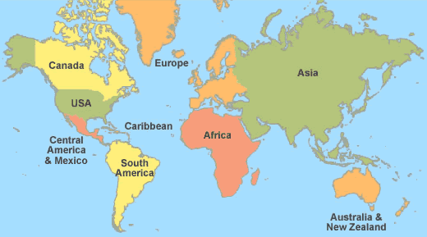
World Map

Slide 9
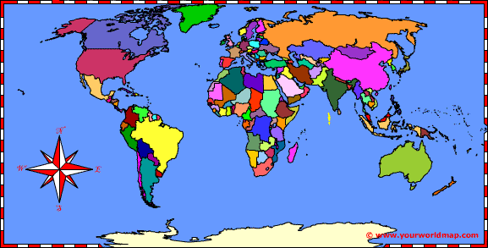
Do you know the Oceans, the continents?

Slide 10
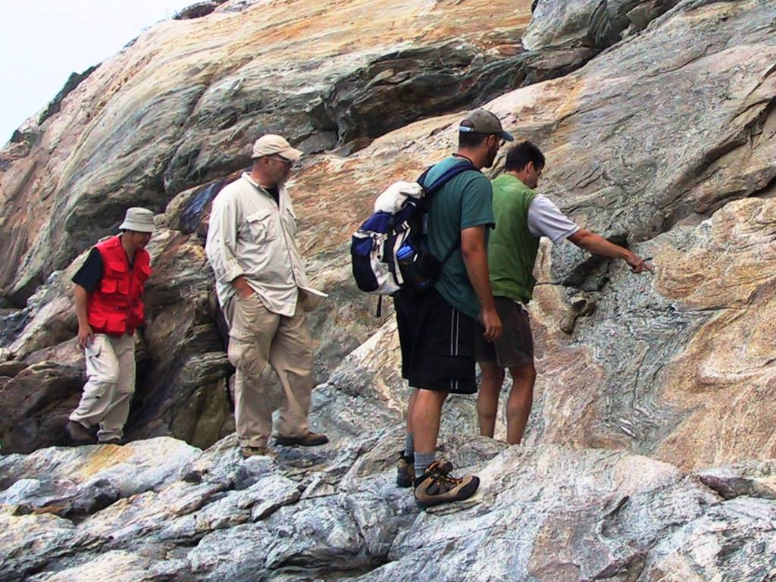
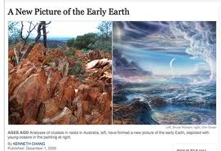
GEOCHRONOLOGY
Geochronology is the science of determining the age of rocks, fossils, and sediments.

Slide 11
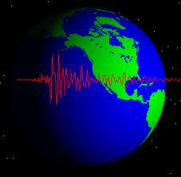
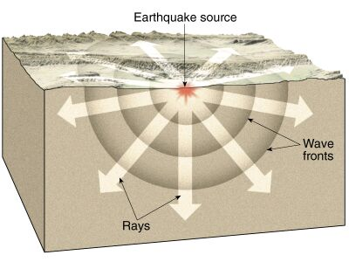
SEISMOLOGY
Seismology /saɪzˈmɒlədʒi/ is the scientific study of earthquakes and the propagation of elastic waves through the Earth.

Slide 12
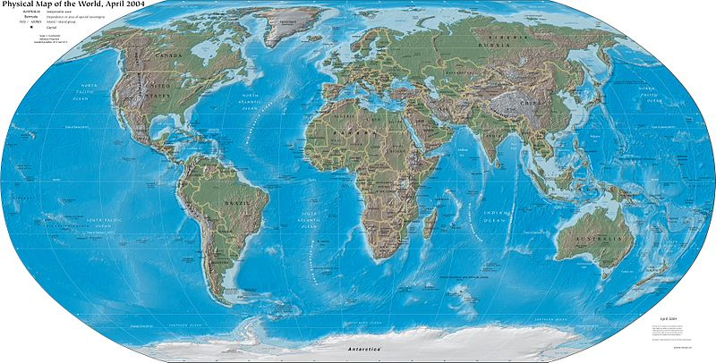
GEOGRAPHY
Geography (from Greek "earth description") is the science that studies the lands, the features, the inhabitants, and the phenomena of the Earth.

Slide 13
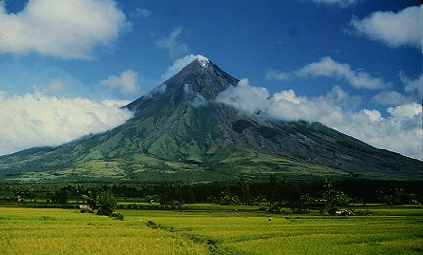
VOLCANOLOGY
Volcanology is a branch of geology that deals with volcanism (the study of volcanoes). Scientists that study volcanology are called volcanologists

Slide 14
Your Task Part 1
Get into the groups according to the letter on your map.
Answer the questions about the map that was assigned to you. Write your answer in your binder on lose leaf lined paper….using complete sentences. Remember to restate the question in your answer.
1.What is your scientific specialty? (one sentence)
2. What information is your map telling you about the world? (2-3 sentences)
3. What do each of the colors on the map represent? Include units. (Can you make a data table that shows this?)
4. Make 5 observations describe any patterns that your map shows. Use the world map to help you describe where in the world you are writing about. (Each observation should be a complete sentence.)
Example: There is a string of volcanoes to the west of Alaska.

Slide 15
Part 2
Get in your number group. You should have 4 different maps in your group now.
Each member of the group is going to share what he/she learned from their map in Part 1. (yesterday) You should be speaking to your group, not copying the answers off their paper.
As you listen, ask questions using the phrases for discussion.

Slide 16
Part 2 continues….
1.What patterns did you learn from the seismologist? (Take notes while the person is speaking, then write a 3-4 sentence reflection on what you learned.)
2. What patterns did you learn from the volocanologist? (Take notes while the person is speaking, then write a 3-4 sentence reflection on what you learned.)
3.What patterns did you learn from the geographer? (Take notes while the person is speaking, then write a 3-4 sentence reflection on what you learned.)
4.What patterns did you learn from the Geochronologist? (Take notes while the person is speaking, then write a 3-4 sentence reflection on what you learned.)
5.Find 3similarities in the patterns between all four maps. (2-3 sentences for each similarity.)
Example: There are volcanoes, earthquakes and shallow water in a line through Iceland. All of the maps have this line on them.

Slide 17
Exit Ticket
How do these maps and the patterns of the earth’s surface relate to what is inside the earth (remember earth’s layers)?

