Slide 1
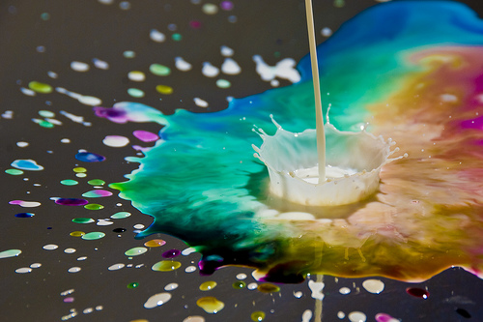
Warm up: What types of things have you done in science in the past? What is your favorite thing you ever learned in science?
Entering Class Procedure:
Come in and go directly to your seat
Open your planner and write down todays CW and HW in the appropriate space.
Get your Daily Catch, write the Learning Target down and any vocabulary words.

Slide 2
Predict – Observe - Explain
Look at the materials at the front of the room.
Listen to the explanation of what is going to be done.
Write down what you think will happen.

Slide 3
Predict – Observe - Explain
Watch what happens as the drop of soap falls into the milk.
Write down what you see happening

Slide 4
Sometimes your group members may have answers you are looking for! Ask them first, then check your notes, then ask me.

Slide 5
Predict – Observe - Explain
Why do you think this happened?
What are some questions you could ask to help you find out more?
How could you answer some of these questions?

Slide 6
Exit Ticket
Re-read your explanation. Turn this explanation into a hypothesis that explains why you think we saw this reaction. (hint… if, then, because)

